Slide 1
IP : Internet Protocol Addresses
Rsc.Asst.Kamil Serhan Bilman
2000900595

Slide 2
What is an IP address?
An IP address is a unique global address for a network interface
An IP address:
  is a 32 bit long identifier
  encodes a network number (network prefix) and a host number

Slide 3
The Abstract Addresses
To provide uniform addressing in an internet, protocol software defines an abstract addressing scheme that assigns each host a unique address.
Users, application programs, and higher layers of protocol software use the abstract addresses to communicate.

Slide 4
The IP Addressing Scheme
Each host is assigned a unique 32-bit number known as the host’s Internet Protocol address.
To transmit information across a TCP/IP (Transmission control protocol) internet, a computer must know the IP addres of the destination and the source.

Slide 5
Important Properties of IPv4
32-bit address
Hierarchical
  Network, subnet, host hierarchy
Each computer is assigned a unique address
Network number assignments must be coordinated globally.
Divided into two parts : prefix and suffix
  Different physical networks – different prefixes
  Same physical network – different suffixes

Slide 6
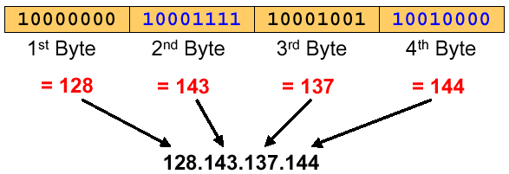
Dotted Decimal Notation
IP addresses are written in a so-called dotted decimal notation
Each byte is identified by a decimal number in the range [0..255]:

Slide 7
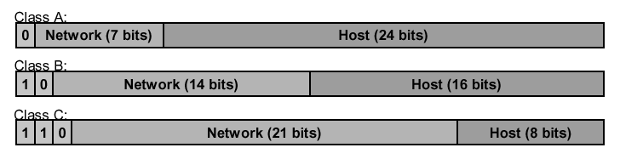
Classes of IP Addresses
Three primary classes

Slide 8
Classes of IP Addresses
Class | From | To
A | 0.0.0.0 | 127.255.255.255
B | 128.0.0.0 | 191.255.255.255
C | 192.0.0.0 | 223.255.255.255
D | 224.0.0.0 | 239.255.255.255
E | 240.0.0.0 | 255.255.255.255

Slide 9
Special IP Addresses
Reserved addresses
  127.0.0.1 loopback address
  Suffix is all 0s name of the network
  Suffix is all 1s broadcast on the network
  Prefix & suffix 0s this computer
Special addresses are reserved and should never be assigned to host computers.

Slide 10
Problems
Too few network addresses for large networks
  Class A and Class B addresses are gone
Two-layer hierarchy is not appropriate for large networks with Class A and Class B addresses.
  Subnetting
Inflexible.
Exploding Routing Tables: Routing on the backbone Internet needs to have an entry for each network address. In 1993, the size of the routing tables started to outgrow the capacity of routers.
The Internet is going to outgrow the 32-bit addresses
  IP Version 6

Slide 11
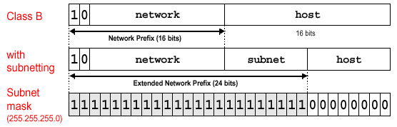
Subnetting
Part of the host number (suffix) can be used to identify a (sub) network
  IP address space has a 3-level hierarchy
  Hosts and routers need to know the subnetmask
Subnetting with mask 255.255.255.0 is quite common.

Slide 12
Advantages of Subnetting
Improves efficiency of IP addresses by not consuming an entire Class B or Class C address for each physical network
Reduces router complexity. Since external routers do not know about subnetting, the complexity of routing tables at external routers is reduced.
With subnetting, IP addresses use a 3-layer hierarchy:
  Network
  Subnet
  Host

Slide 13
IPv4 Address Model
IP addresses
  Decimal-dot notation
  Host in class A network
    56.0.78.100 www.usps.gov
  Host in class B network
    128.174.252.1 www.cs.uiuc.edu
  Host in class C network
    198.182.196.56 www.linux.org
Internet domain names
  ASCII strings separated by periods
  Provides some administrative hierarchy
    host.subdomain.domain.domain_type (com, edu, gov, org, …)
    host.domain.country (us, de, jp, …)

Slide 14
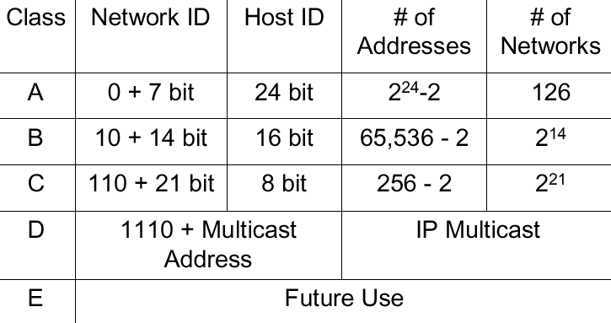
IPv4 Address Model

Slide 15
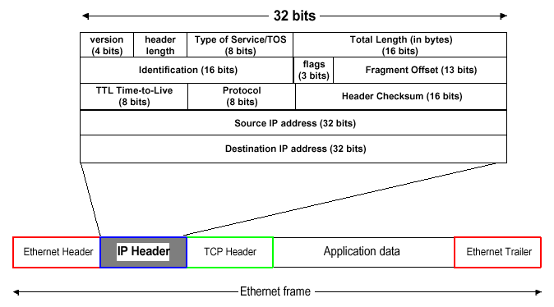
IPv4 Header

Slide 16
IPv4 Address Translation
IP addresses to LAN physical addresses
  Problem
    An IP route can pass through many physical networks
    Data must be delivered to destination’s physical network
    Hosts only listen for packets marked with physical interface names
  Solution
    Translate from IP address to physical address
    Address Resolution Protocol (ARP)
Internet domain name to IP address
  Domain to IP translation
    Domain Name Service (DNS)

Slide 17
IP to Physical Address
Translation
Hard-coded
  Encode physical address in IP address
  Ex: Map Ethernet addresses to IP addresses
    Makes it impossible to associate address with topology
Fixed table
  Maintain a central repository and distribute to hosts
    Bottleneck for queries and updates
Automatically generated table
  Use ARP to build table at each host
  Use timeouts to clean up table

Slide 18
ARP
Check table for physical address
If address not present
  Broadcast a query, include host’s translation
  Wait for a response
Upon receipt of ARP query/response
  Targeted host responds with address translation
  If address already present
    Refresh entry and reset timeout
  If address not present
    Add entry for requesting host
    Ignore for other hosts
Timeout and discard entries

Slide 19
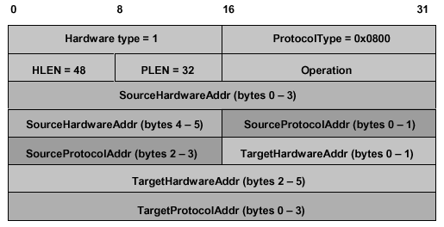
ARP Packet

Slide 20
ARP Packet
Hardware type
  Type of physical network (e.g. Ethernet)
Protocol type
  Higher layer protocol (e.g. IP)
HLEN
  Hardware (link-layer) address length
PLEN
  Protocol address length
Operation
  Request or response
Source and target hardware address
Source and target protocol address

Slide 21
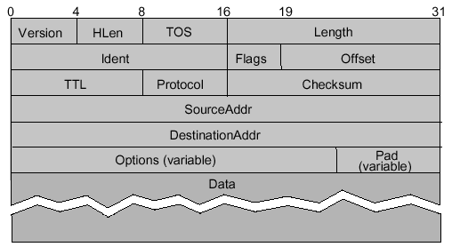
IP Packet Format

Slide 22
IP Packet Format
4-bit version
  IPv4 = 4, IPv6 = 6
4-bit header length
  Counted in words, minimum of 5
8-bit type of service field (TOS)
  Mostly unused
16-bit data length
  Counted in bytes

Slide 23
IP Packet Format
Fragmentation support
  16-bit packet ID
    All fragments from the same packet have the same ID
  3-bit flags
    1-bit to mark last fragment
  13-bit fragment offset into packet
    Counted in words
8-bit time-to-live field (TTL)
  Hop count decremented at each router
  Packet is discard if TTL = 0

Slide 24
IP Packet Format
8-bit protocol field
  TCP = 6, UDP = 17
16-bit IP checksum on header
32-bit source IP address
32-bit destination IP address
Options
  Variable size
  Source-based routing
  Record route
Padding
  Fill to 32-bit boundaries

Slide 25
IP Fragmentation and
Reassembly
Problem
  Different physical layers provide different limits on frame length
    Maximum transmission unit (MTU)
  Source host does not know minimum value
    Especially along dynamic routes
Solution
  When necessary, split IP packet into acceptably sized packets prior to sending over physical link
  Questions
    Where should reassembly occur?
    What happens when a fragment is damaged/lost?

Slide 26
IP Fragmentation and
Reassembly
Fragments are self-contained IP packets
Reassemble at destination to minimize refragmentation
Drop all fragments in packet if one or more fragments are lost
Avoid fragmentation at source host
  Transport layer should send packets small enough to fit into one MTU of local physical network
    Must consider IP header

Slide 27
Host Configuration
What configuration information does a host need?
  Its IP address
  Default router address
Reverse Address Resolution Protocol (RARP)
  Translate physical address to IP address
  Used to boot diskless hosts
  Host broadcasts request to boot
  RARP server tells host the host’s own IP address
Implementation at a higher level
  DHCP

Slide 28
Dynamic Host Configuration
Protocol (DHCP)
A simple way to automate configuration information
  Network administrator does not need to enter host IP address by hand
  Good for large and/or dynamic networks

Slide 29
Internet Control Message
Protocol (ICMP)
Handles error and control messages
Error Messages
  Host unreachable
  Reassembly failed
  IP checksum failed
  TTL exceeded (packet dropped)
  Invalid header
Control Messages
  Echo/ping request and reply
  Echo/ping request and reply with timestamps
  Route redirect

Slide 30
IPv6 – IP version 6
Is the successor to the currently used IPv4
  Specification completed in 1994
  Makes improvements to IPv4 (no revolutionary changes)
One feature of IPv6 is a significant increase of the IP address to 128 bits (16 bytes)
  IPv6 will solve – for the foreseeable future – the problems with IP addressing

Slide 31
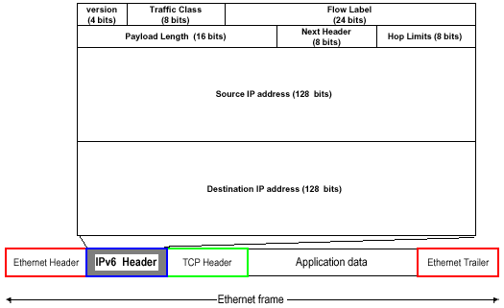
IPv6 Header

Slide 32
IPv6 versus IPv4
IPv4 has a maximum of
  2³² ~ 4 billion addresses
IPv6 has a maximum of
  2¹²⁸ ~ (2³²)⁴
  4 billion x 4 billion x 4 billion x 4 billion addresses

Slide 33
Thank you

